Slide 1


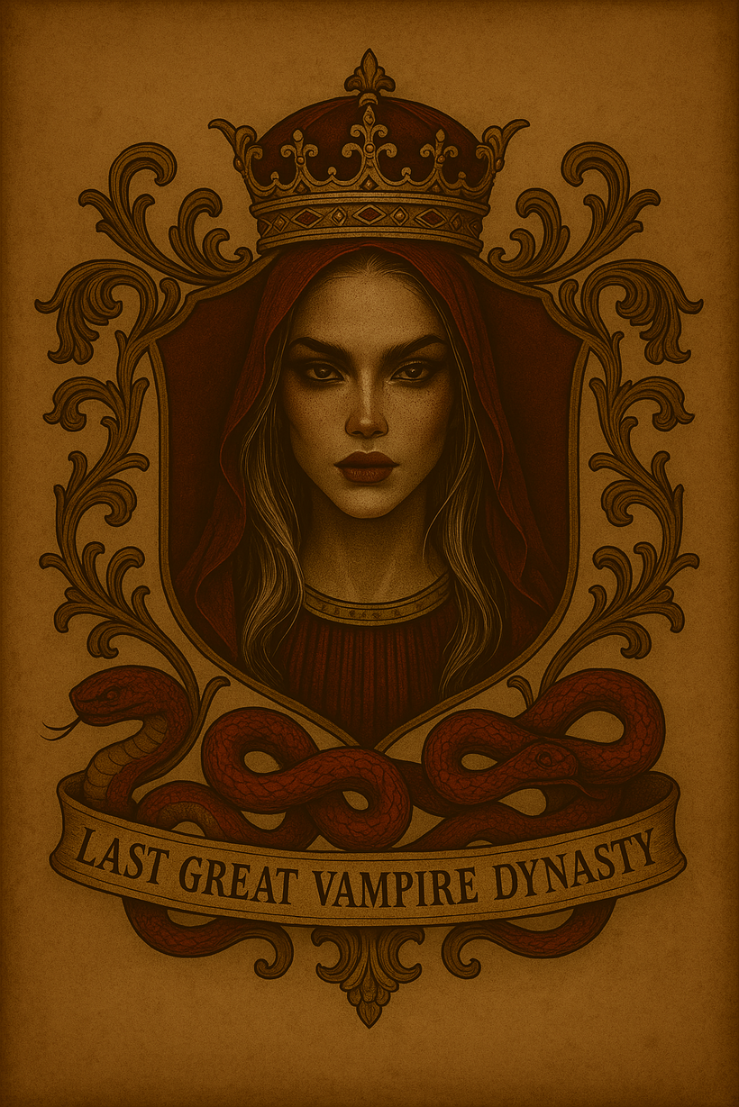

The Last Great
Vampire Dynasty

Slide 2
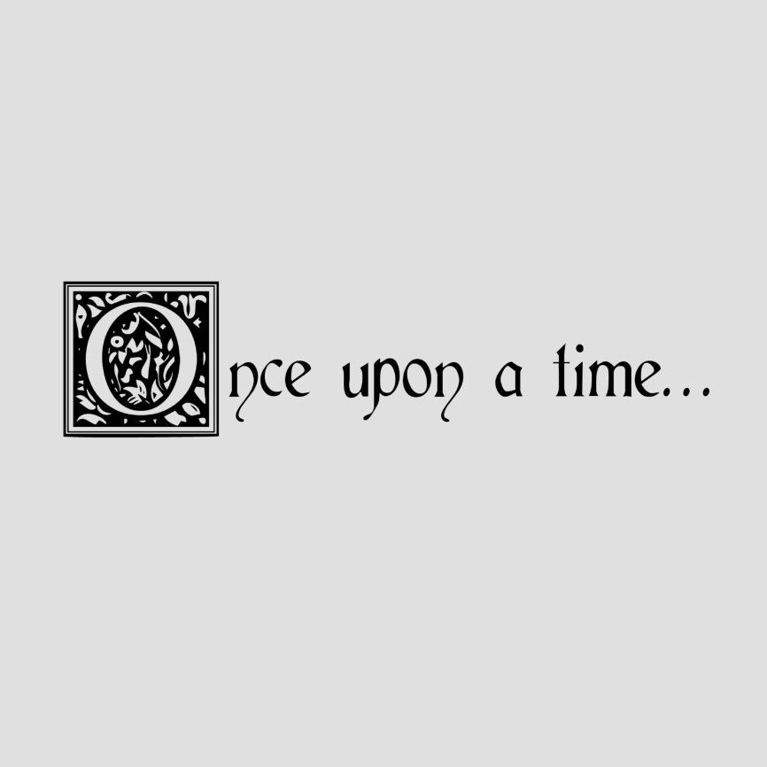

Slide 3
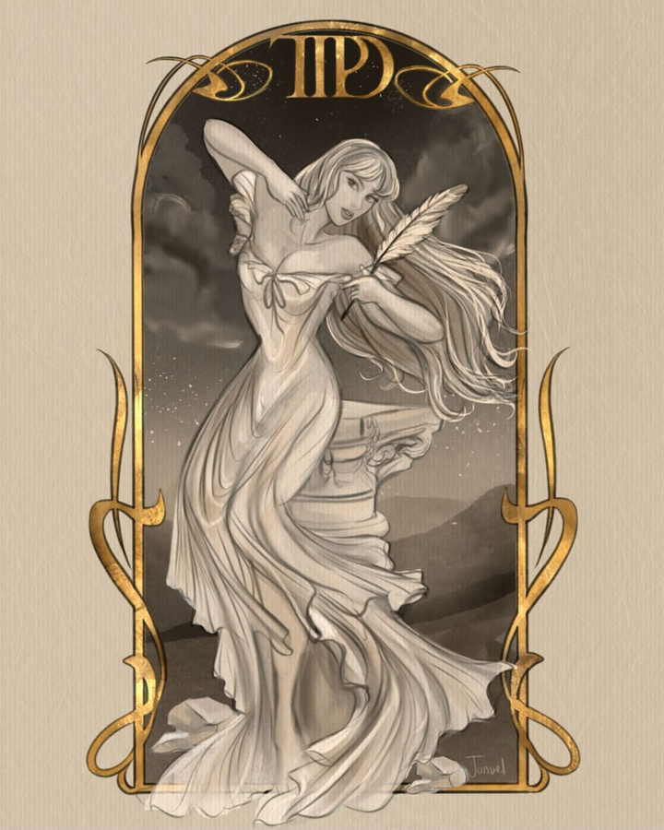
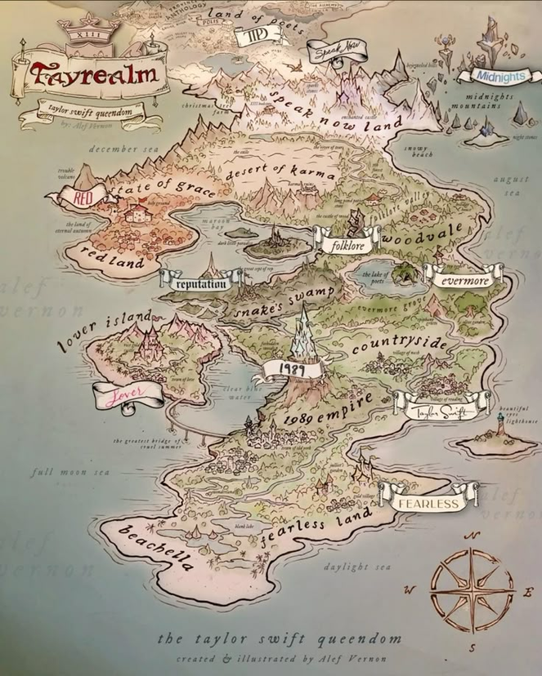
St. Harmonia ruled over Tayrealm as a Benevolent Queen.

Slide 4
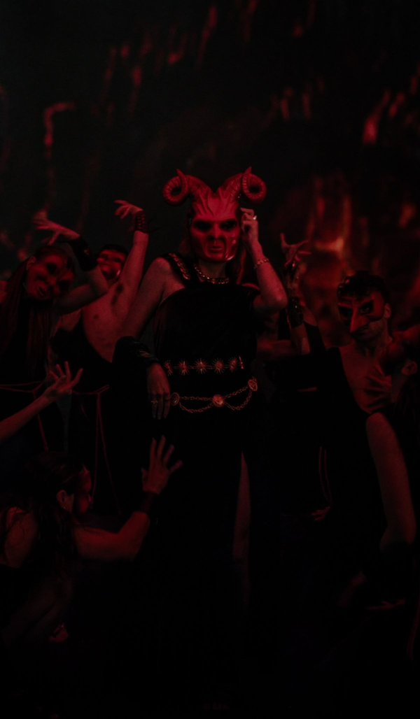
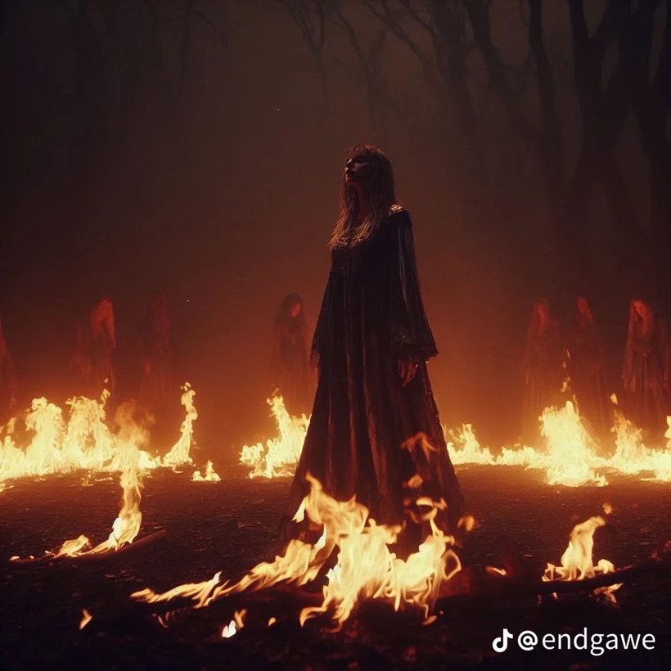
Until some of the Royal Moroi families staged a coup and burned her at the stake for witchcraft, in an effort to steal her power.

Slide 5
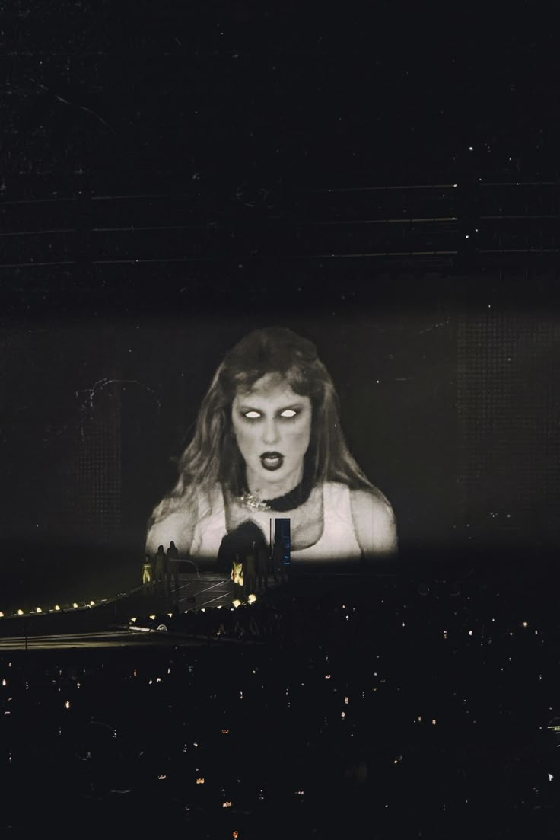
The Prophecy
But Harmonia, sensing her demise...

Slide 6
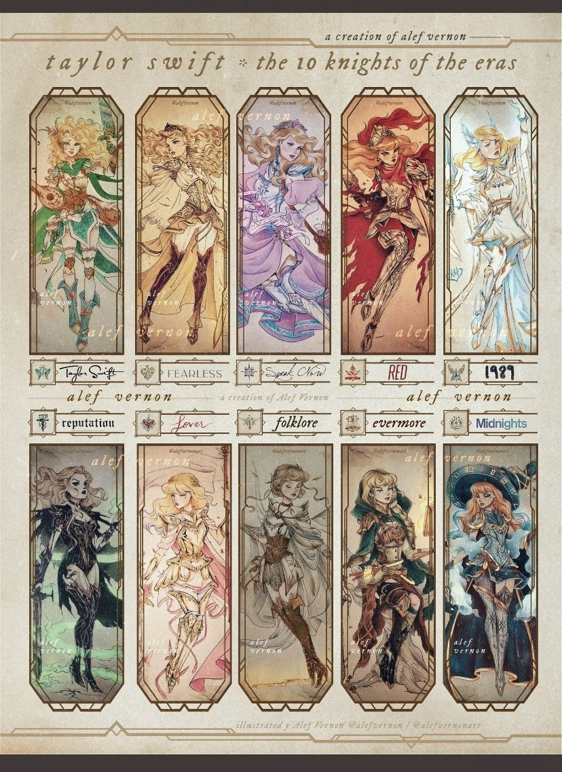
...gathered her Knights

Slide 7
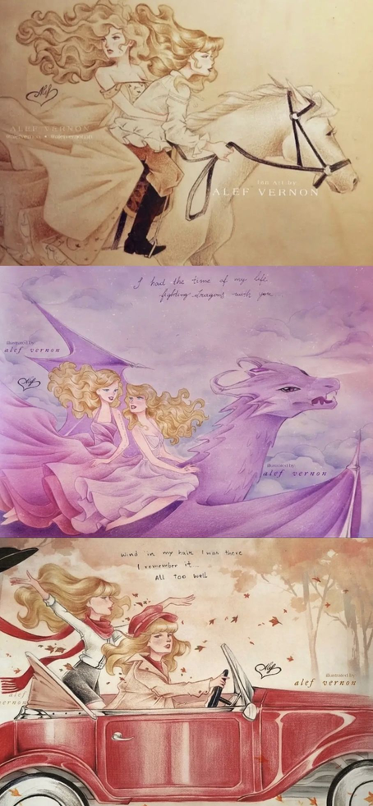
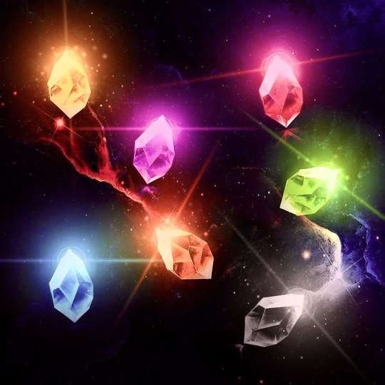
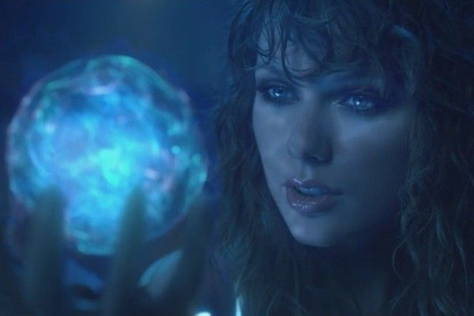
...divided her powers, sent the knights to scattered it across the realm,

Slide 8
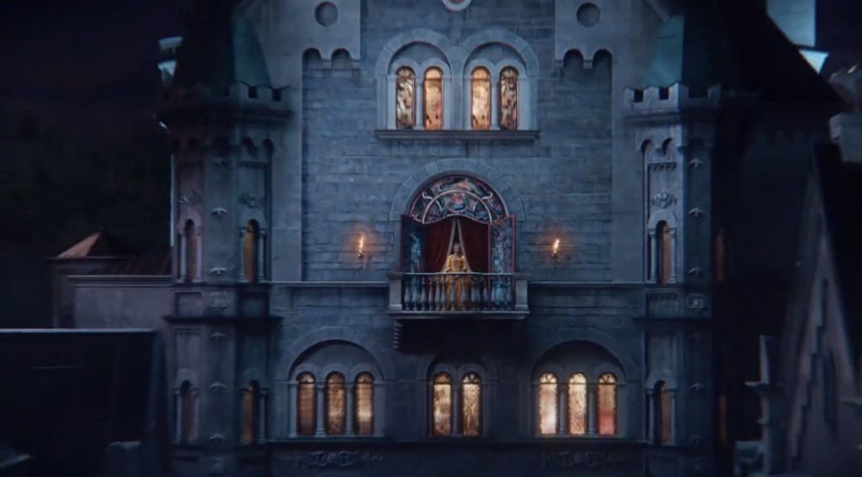
knowing one day an heir would come to reclaim the land ... or so the story goes.

Slide 9

89 years later

Slide 10
Queen Tatianna is looking to step down. Princess Valsalise (Lisa) Dragomir
would be next in line if she had a family quorum. However, because she is the last in her bloodline, the next in line for the throne is Prince Victor Dashko. His archaic and oppressive beliefs, including his treatment of dhampirs, opposes everything Lisa stands for. If Lisa were to rule, dhampirs would have more control over their lives, and whether they live it to serve the Moroi (the royal vampires). In order for her to block Victor from the throne, she needs to find the Crown of Harmonia. It is rumored that St. Harmonia used the powers granted by the crown to rule the Continent (Tayrealm) many years ago. The ancient texts don’t say exactly what the crown did, only that it held ten crystals. When Harmonia passed, she didn’t trust the power of the crown with anyone, so she separated the crystals from the crown, and the story of the crown has faded into folklore. In addition, Lisa recently found out she has a cousin in hiding that would give her the family quorum she needs. All she has is a golden medallion that activates when imbued with blood from her kin. You have 13 days to find the stones, locate her cousin, and prevent Victor’s coronation. The liberation of the dhampirs depends on you.

Slide 11
The Death Rattle of Harmonia
Dear Reader,
Do not let my elegies serve only to eulogize me.
Let them be lanterns. Let them lead.
As I sit here, watching my bridges burn and my castle crumble,
I ask only this:
Learn from my mistakes.
They came with pitchforks and their ‘proof,’
But the usurpers who exalt the one and betray the many
Will not endure.
I will rise from the dead once again
But until that day,
This is my mourning warning:
I cannot promise peace to those who seek my power
Only that the rain will come.
It always does.
So go forth.
Seek the ten. Gather what was broken.
Let my songs be your compass, your cipher, your shield.
But above all
Keep the courage of your convictions.

Slide 12
The prophesy
They’ll burn me at the witch’s stake,
caged and killed for power’s sake.
But my power is not theirs to end,
broken and scattered in pieces ten.
May the land of my birthright
be haunted by my chosen Knights
And when decade ends, a new age starts
a queen shall rise from fractured parts
Bejeweled in strength they tried to bind,
the orphan will come, of dragon kind.
With my sworn knights at her command,
she’ll rise up to reclaim the land.
Marked by cynics outraged, shrieking this is absurd
but their morals are corrupt & blurred
descendants of those that burned the bitch,
now reap the curse their elders stitched.
She will an Era of equality sow
a crown reborn, the realm aglow.
A hymn to Harmony in her heart
her reign is where Karma finds her start.

Slide 13
Harmonia’s Golden Rule
Never be so polite, you forget your power, Never wield such power, you forget to be polite.

